Slide 1
INSERTION SORT ALGORITHM

Slide 2
What Is Insertion Sort?
Insertion sort is a method of sorting an array by dividing the array into sorted portion and unsorted portion.
Then we compare the unsorted item to see if it is bigger than the previous element, if not we insert the new item.
Basically, we are looking from left to right and sorting as we go!

Slide 3
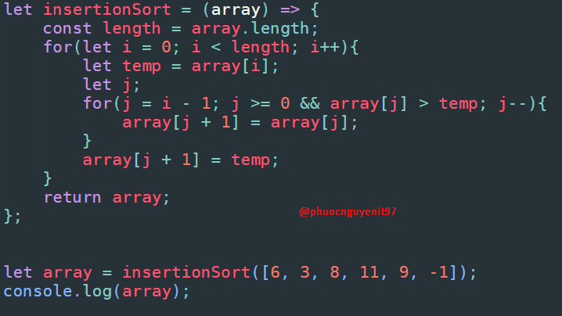
Install Insertion Sort Algorithm

